Slide 1
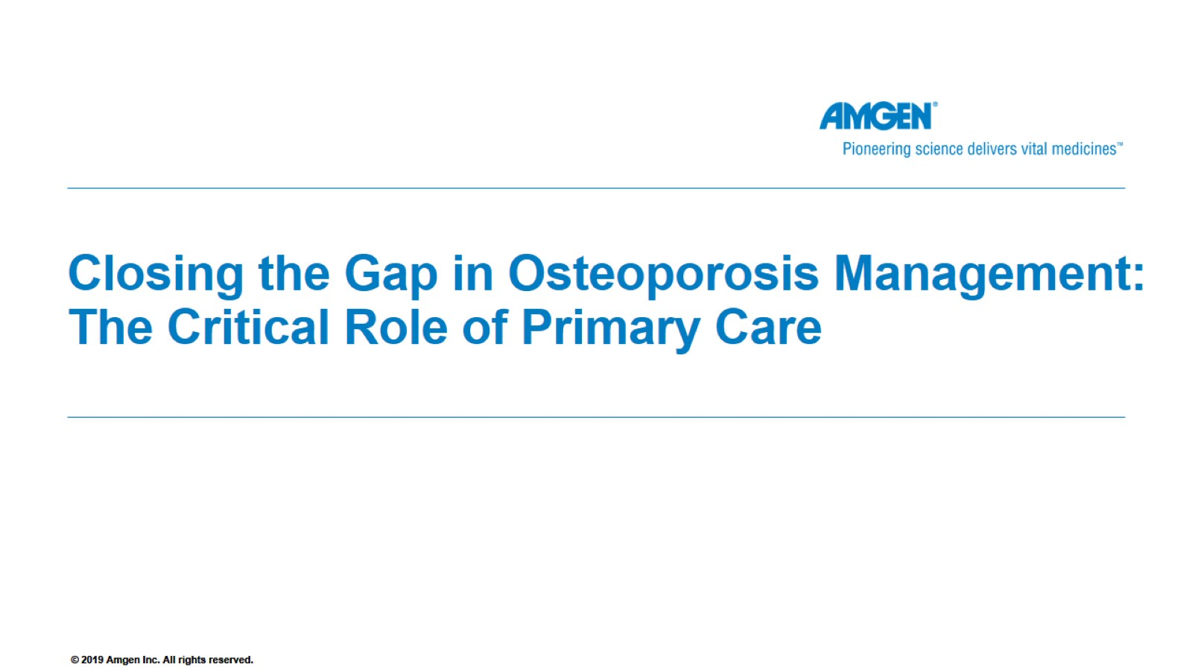
Closing the Gap in Osteoporosis Management:
The Critical Role of Primary Care
SC-AT-AMG162-00712 1021

Slide 2
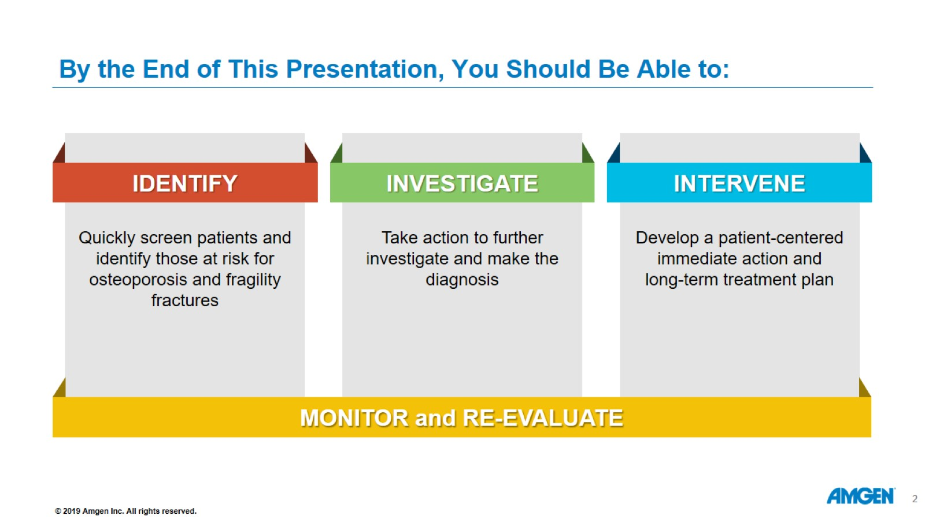
By the End of This Presentation, You Should Be Able to:

Slide 3
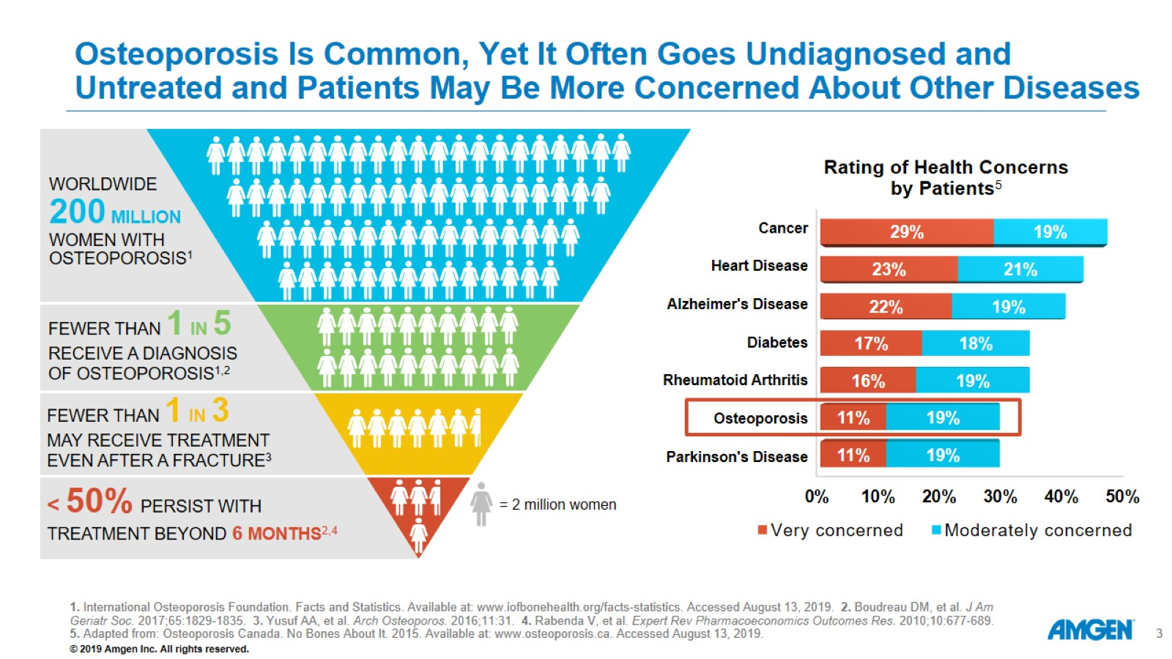
Osteoporosis Is Common, Yet It Often Goes Undiagnosed and Untreated and Patients May Be More Concerned About Other Diseases

Slide 4
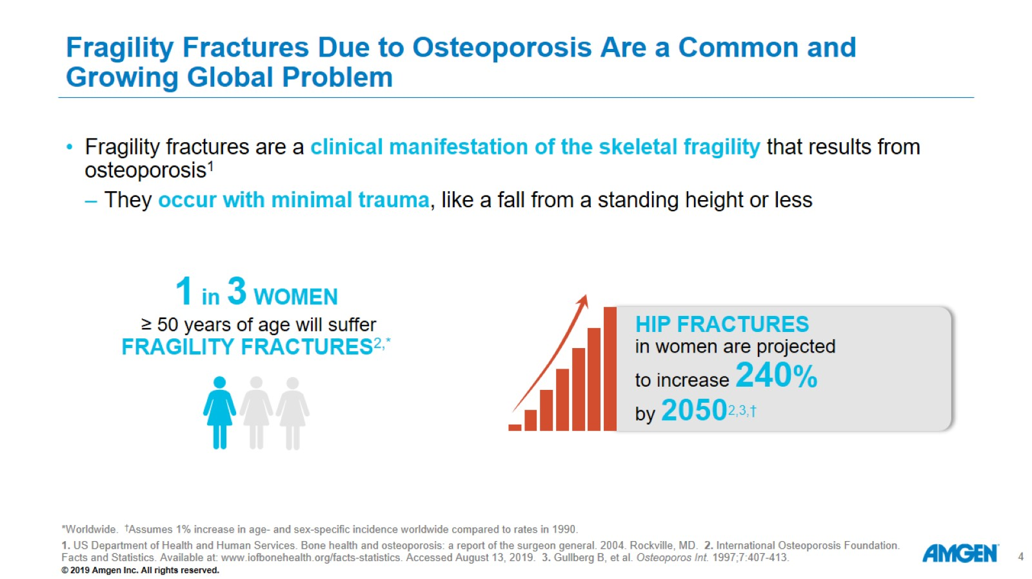
Fragility Fractures Due to Osteoporosis Are a Common and Growing Global Problem

Slide 5
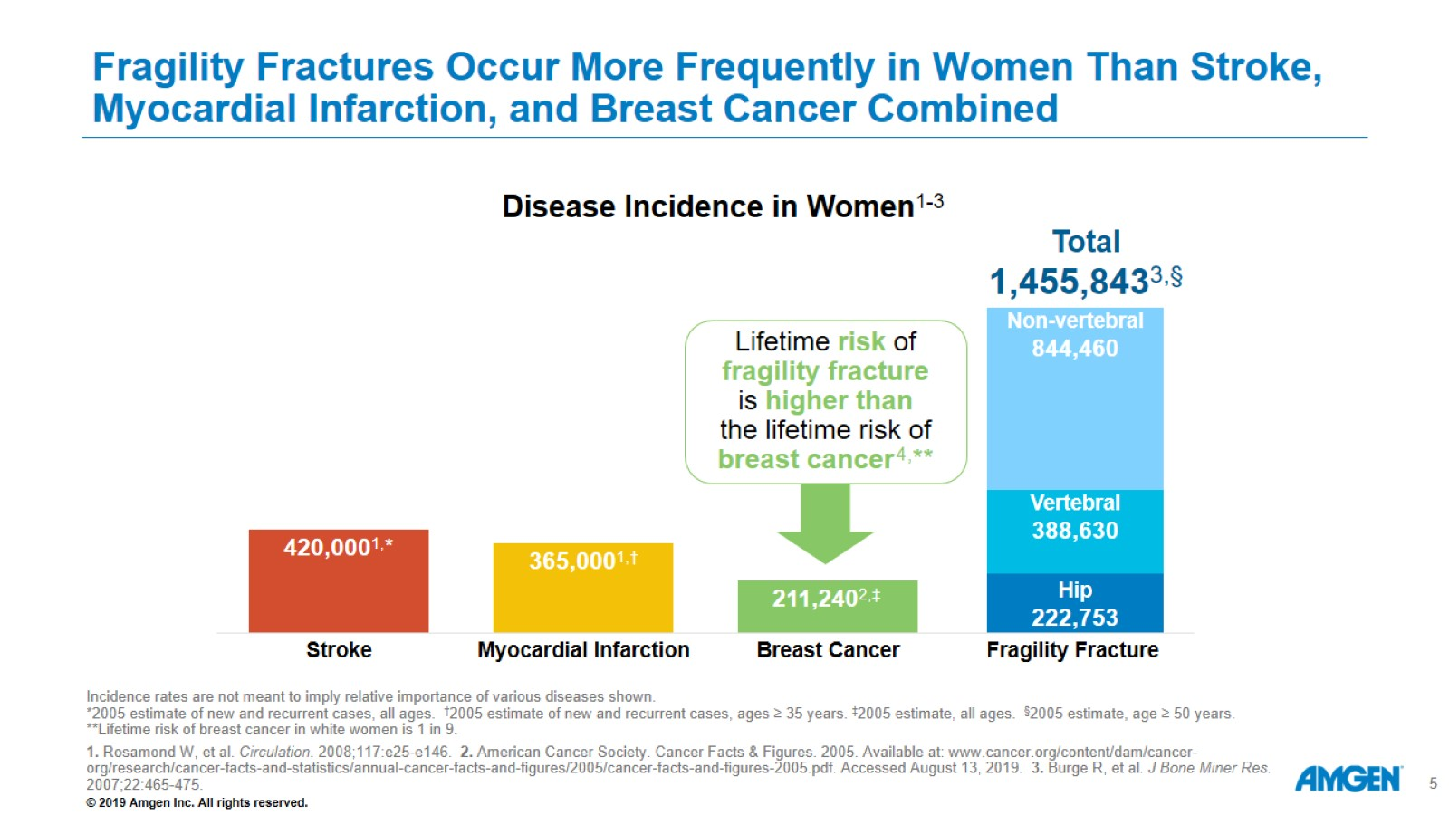
Fragility Fractures Occur More Frequently in Women Than Stroke, Myocardial Infarction, and Breast Cancer Combined

Slide 6
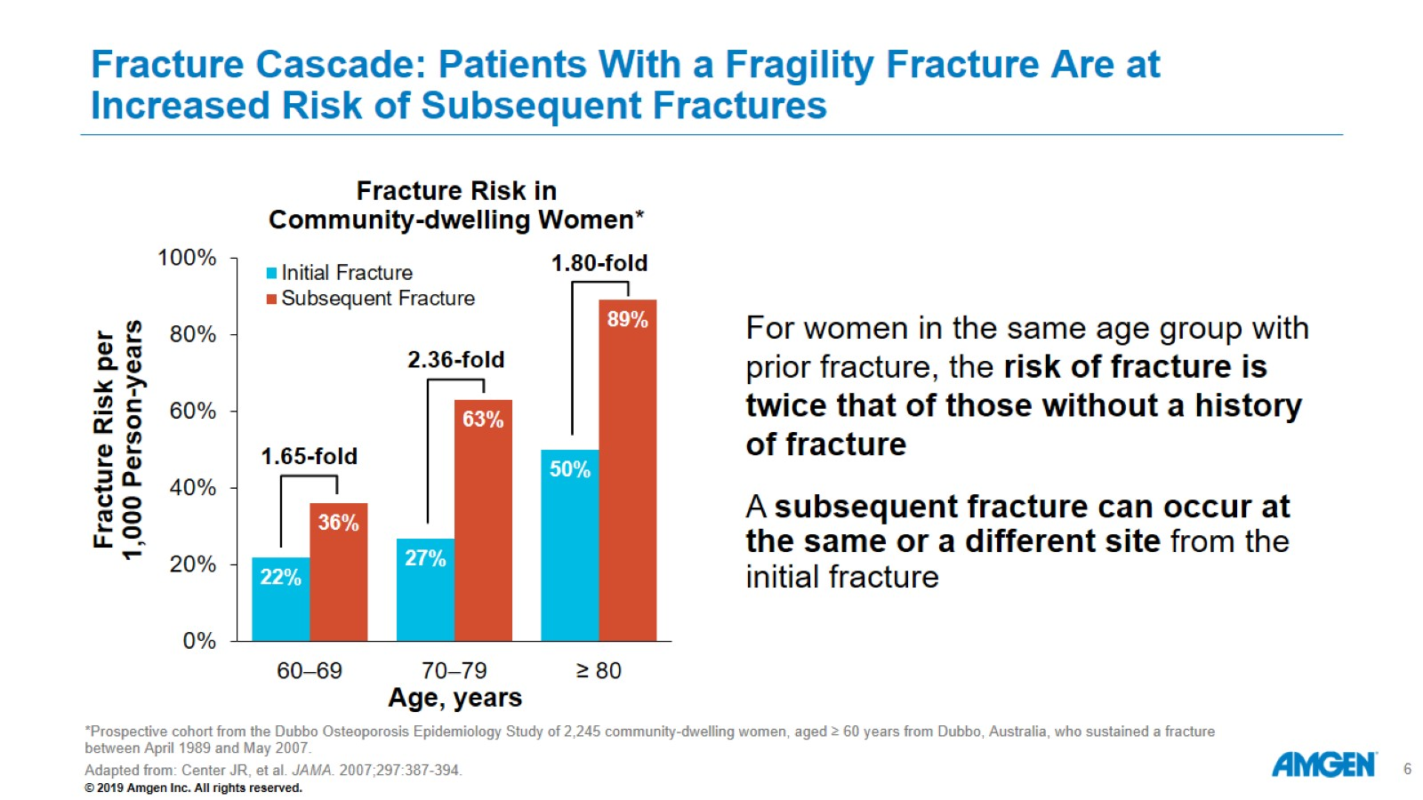
Fracture Cascade: Patients With a Fragility Fracture Are at Increased Risk of Subsequent Fractures

Slide 7
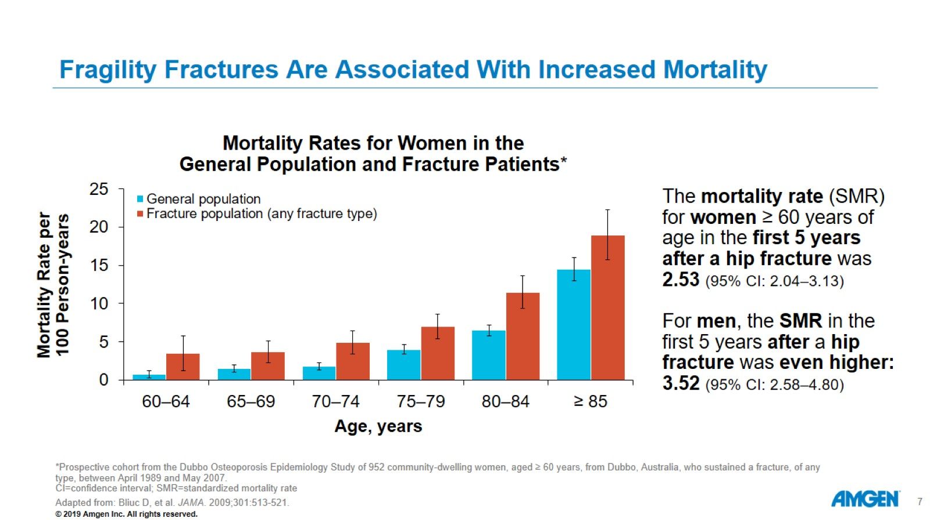
Fragility Fractures Are Associated With Increased Mortality

Slide 8
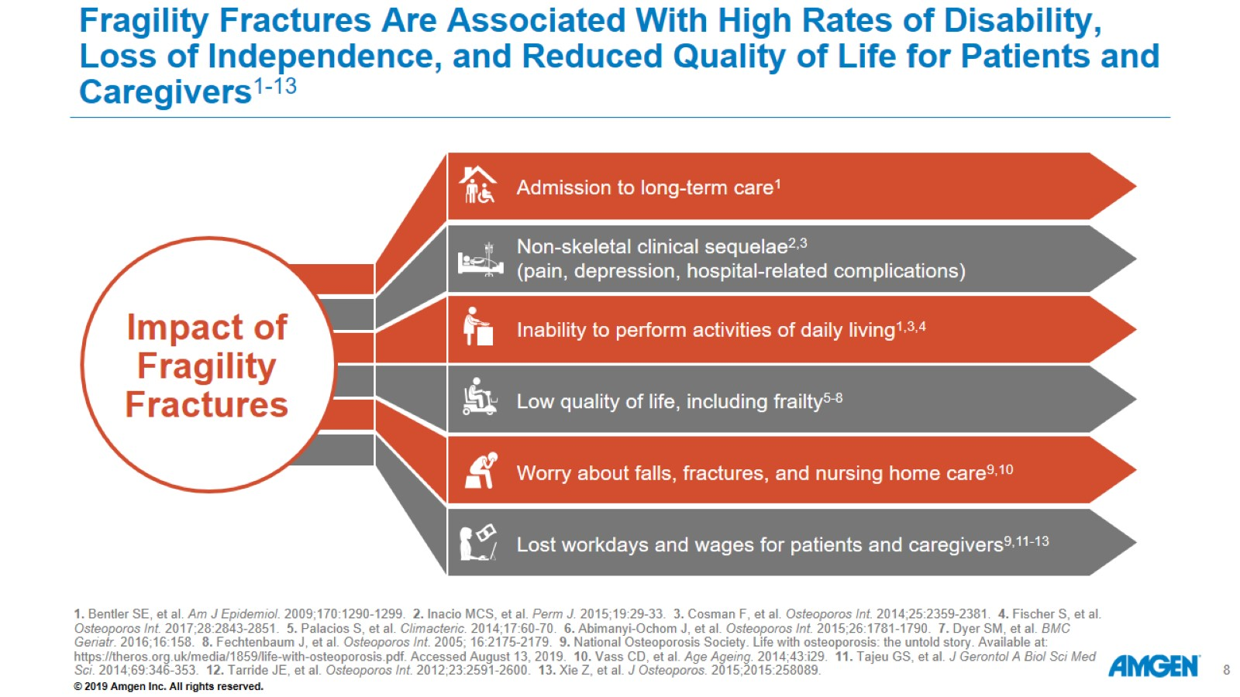
Fragility Fractures Are Associated With High Rates of Disability, Loss of Independence, and Reduced Quality of Life for Patients and Caregivers¹⁻¹³

Slide 9
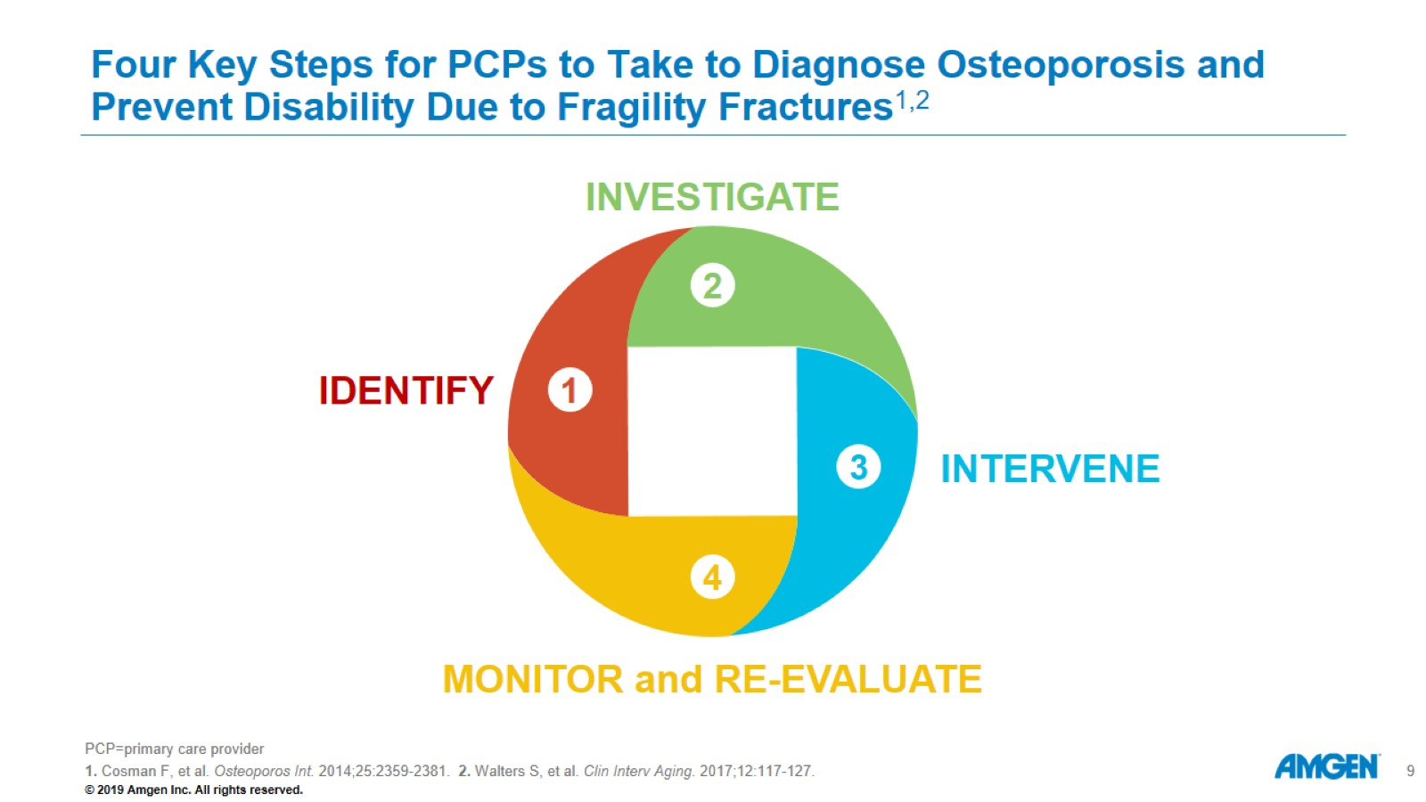
Four Key Steps for PCPs to Take to Diagnose Osteoporosis and Prevent Disability Due to Fragility Fractures^{1,2}

Slide 10
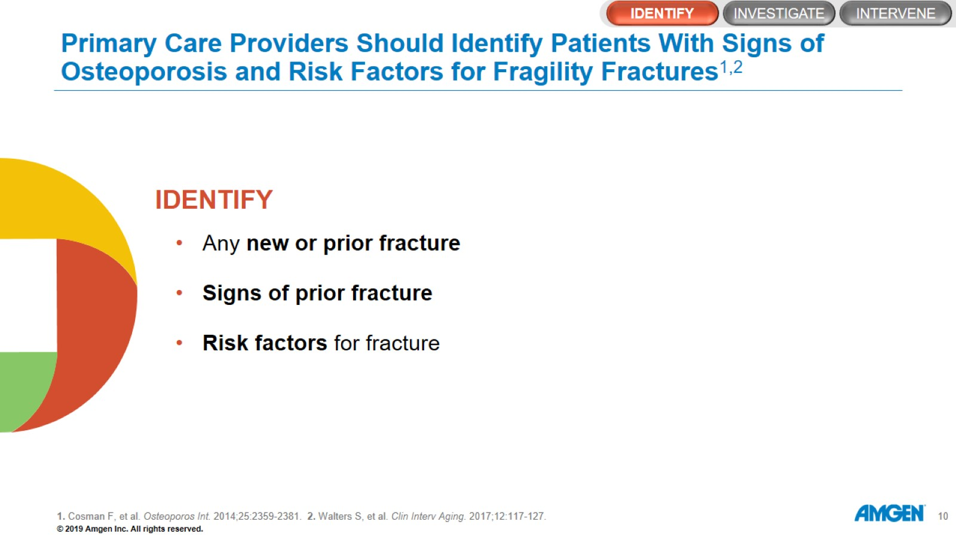
Primary Care Providers Should Identify Patients With Signs of Osteoporosis and Risk Factors for Fragility Fractures^{1,2}

Slide 11
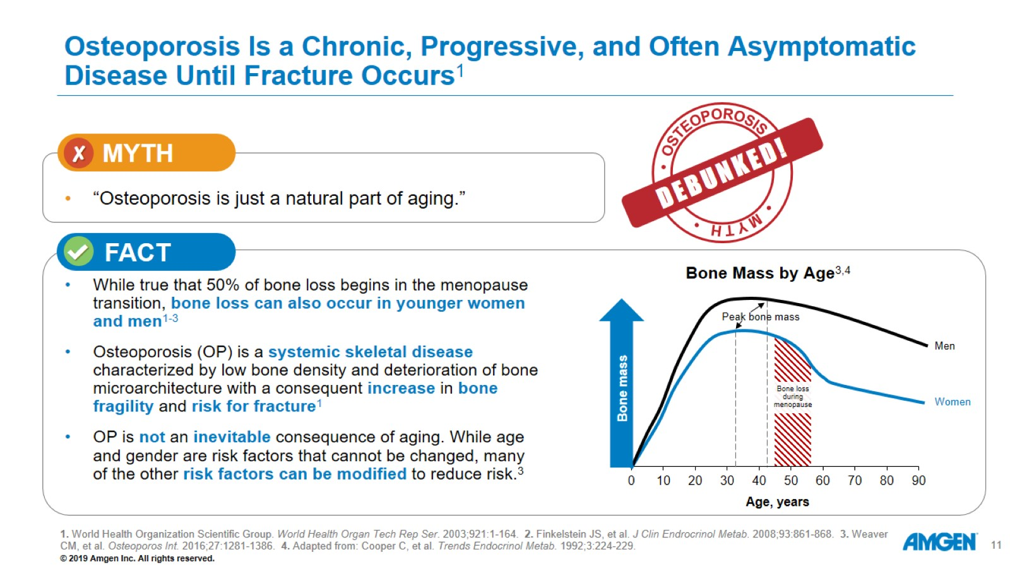
Osteoporosis Is a Chronic, Progressive, and Often Asymptomatic Disease Until Fracture Occurs¹

Slide 12
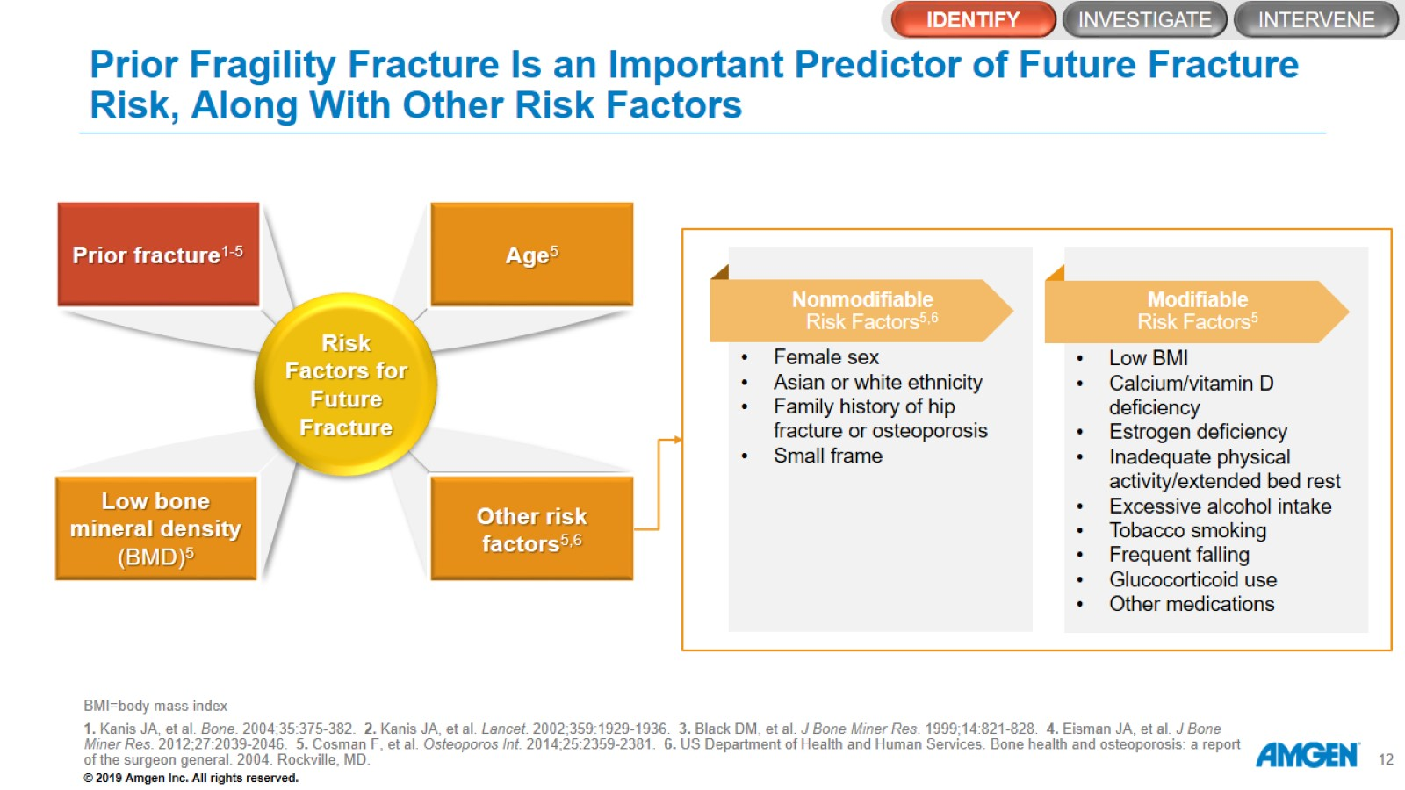
Prior Fragility Fracture Is an Important Predictor of Future Fracture Risk, Along With Other Risk Factors

Slide 13
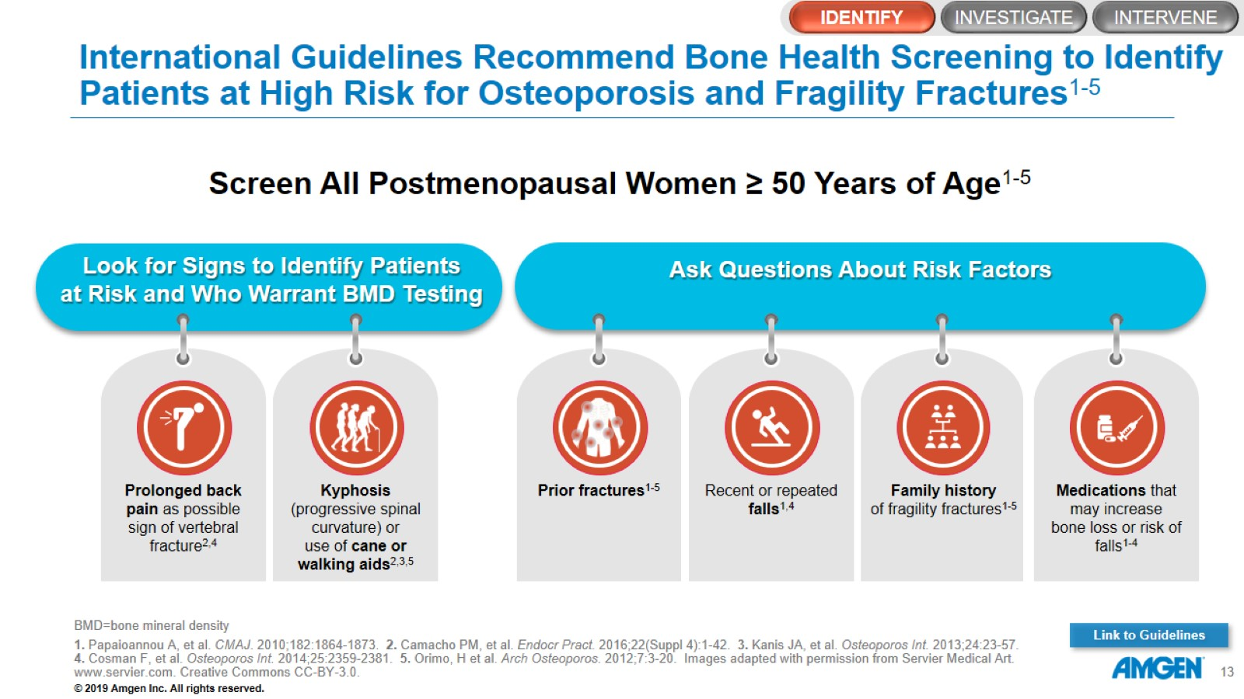
International Guidelines Recommend Bone Health Screening to Identify Patients at High Risk for Osteoporosis and Fragility Fractures¹⁻⁵

Slide 14
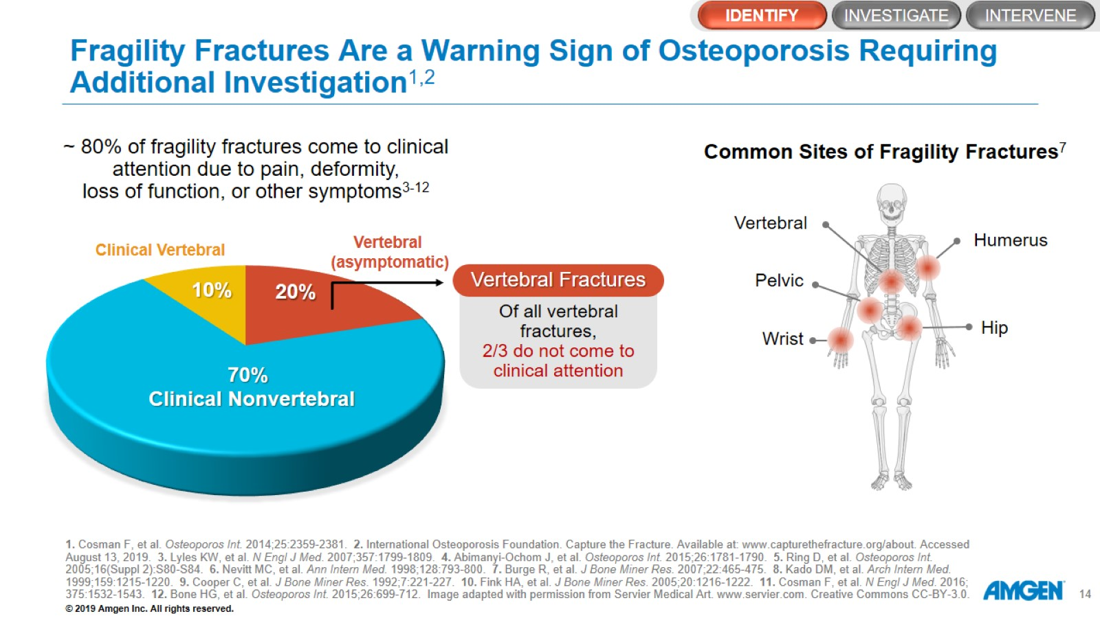
Fragility Fractures Are a Warning Sign of Osteoporosis Requiring Additional Investigation^{1,2}

Slide 15
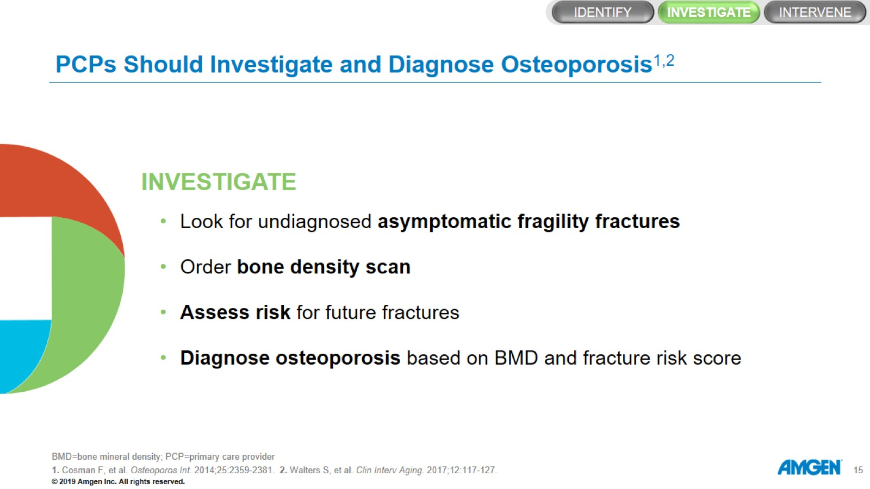
PCPs Should Investigate and Diagnose Osteoporosis^{1,2}

Slide 16
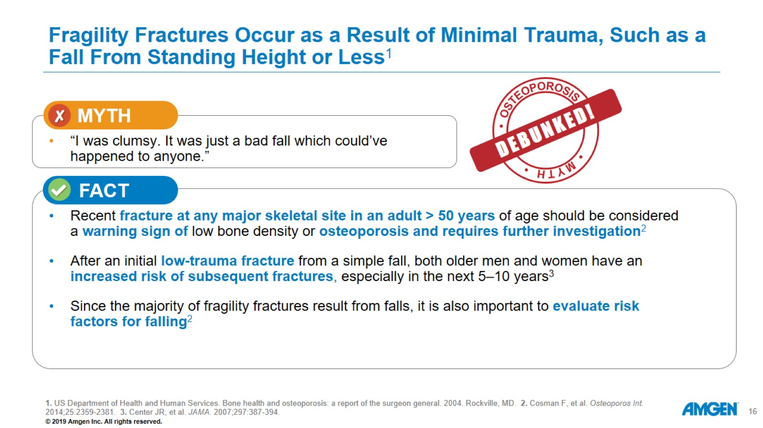
Fragility Fractures Occur as a Result of Minimal Trauma, Such as a Fall From Standing Height or Less¹

Slide 17
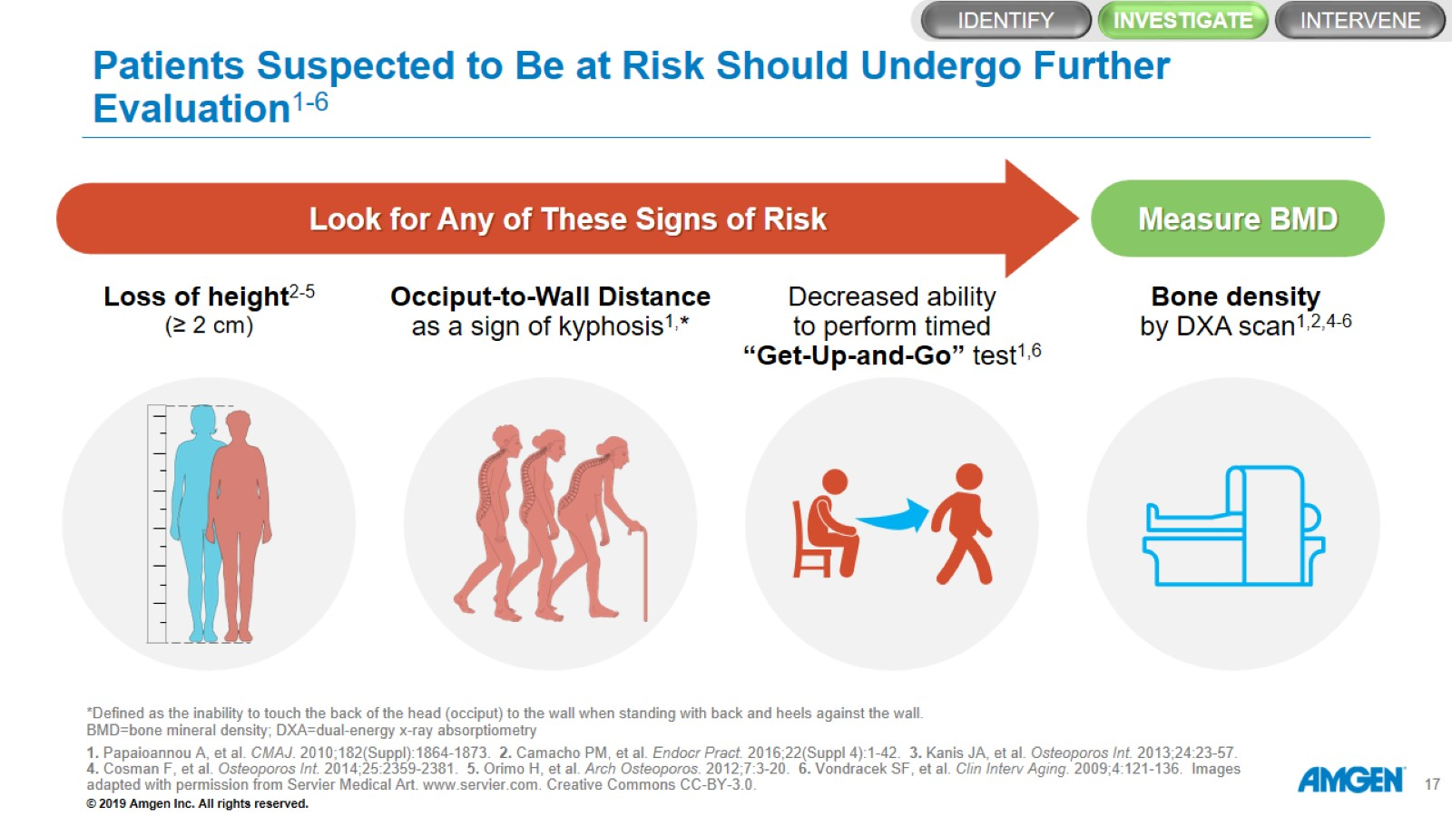
Patients Suspected to Be at Risk Should Undergo Further Evaluation¹⁻⁶

Slide 18
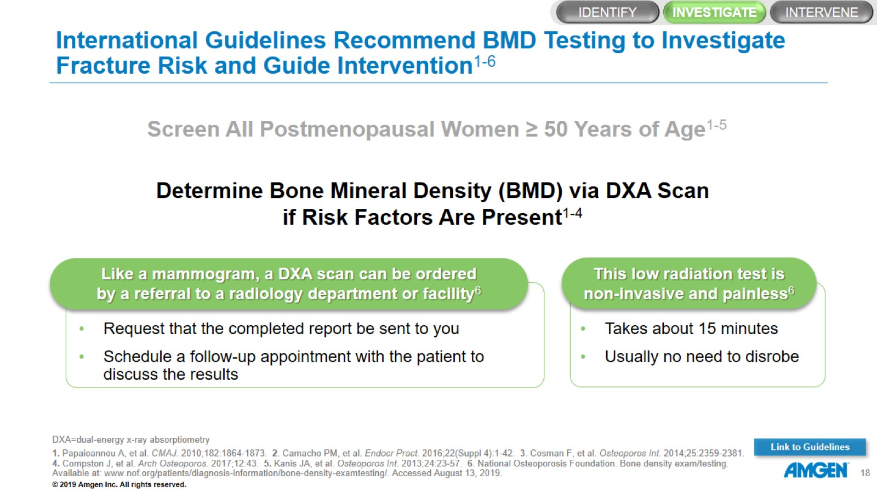
International Guidelines Recommend BMD Testing to Investigate Fracture Risk and Guide Intervention¹⁻⁶

Slide 19
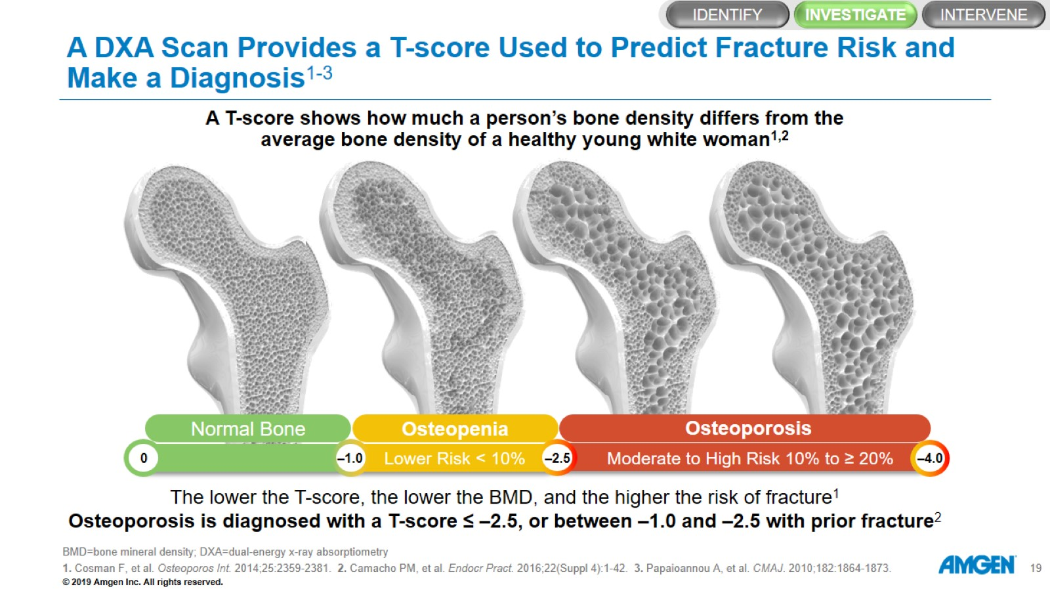
A DXA Scan Provides a T-score Used to Predict Fracture Risk and Make a Diagnosis¹⁻³

Slide 20
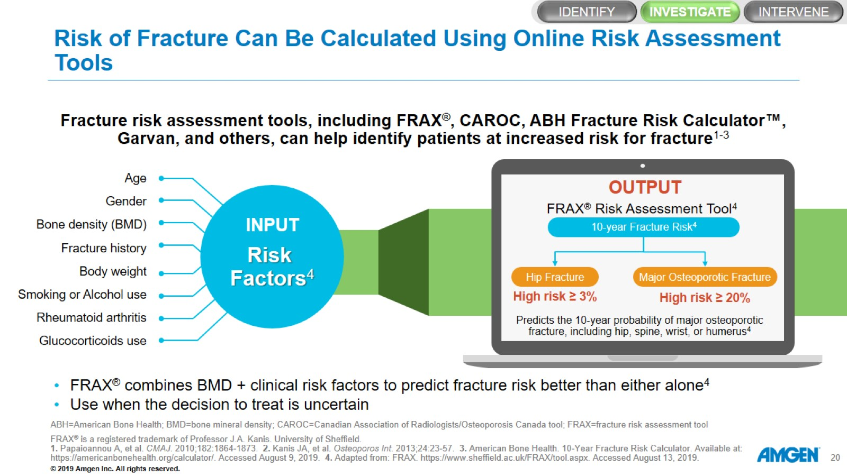
Risk of Fracture Can Be Calculated Using Online Risk Assessment Tools
5%

Slide 21
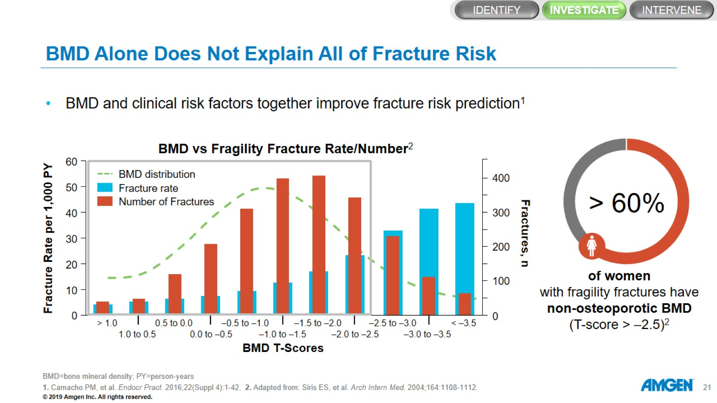
BMD Alone Does Not Explain All of Fracture Risk

Slide 22
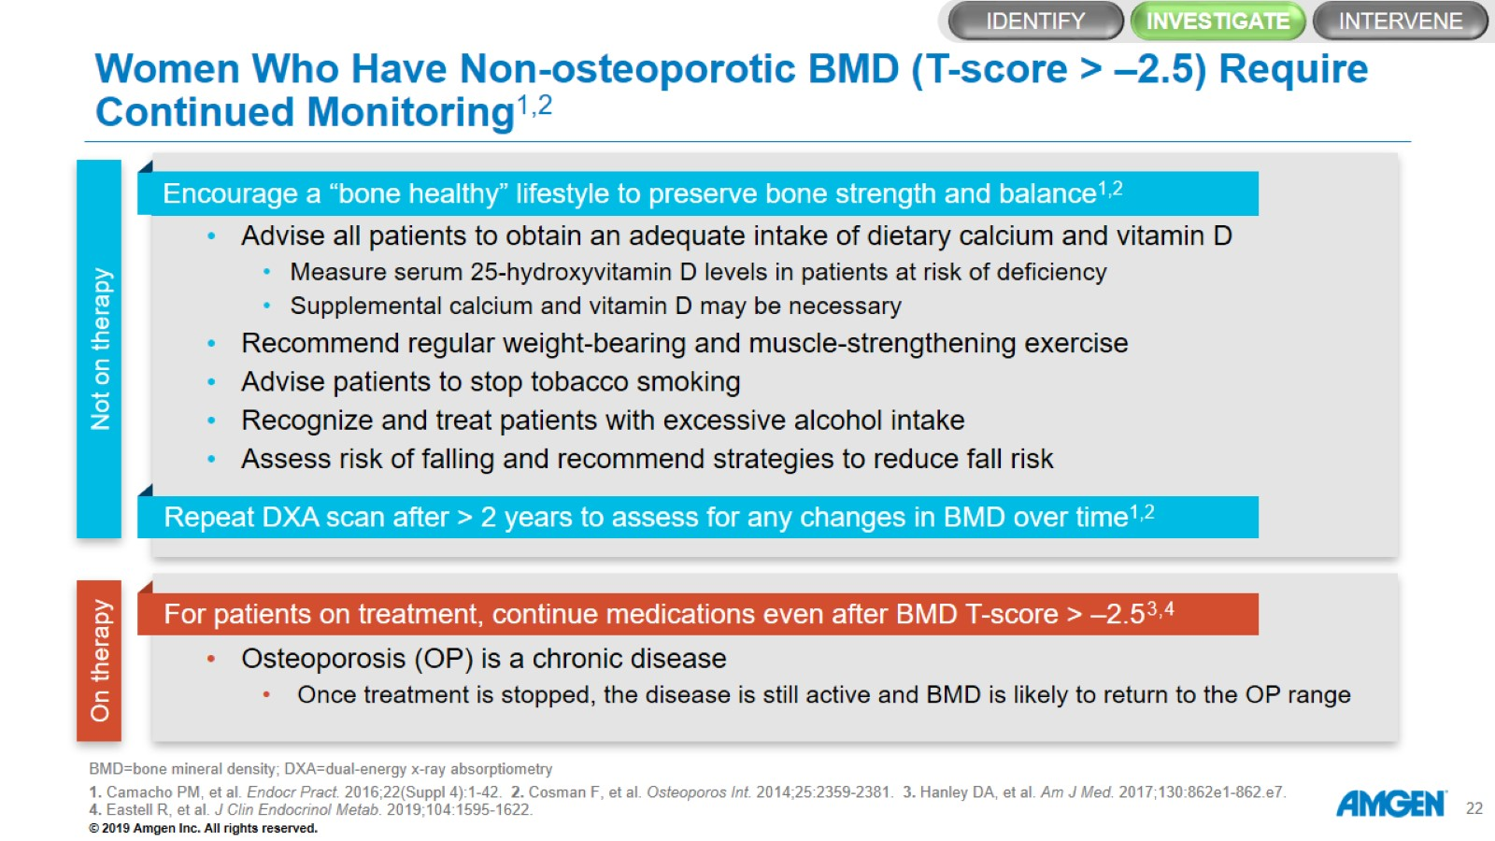
Women Who Have Non‑osteoporotic BMD (T-score > –2.5) Require Continued Monitoring^{1,2}

Slide 23
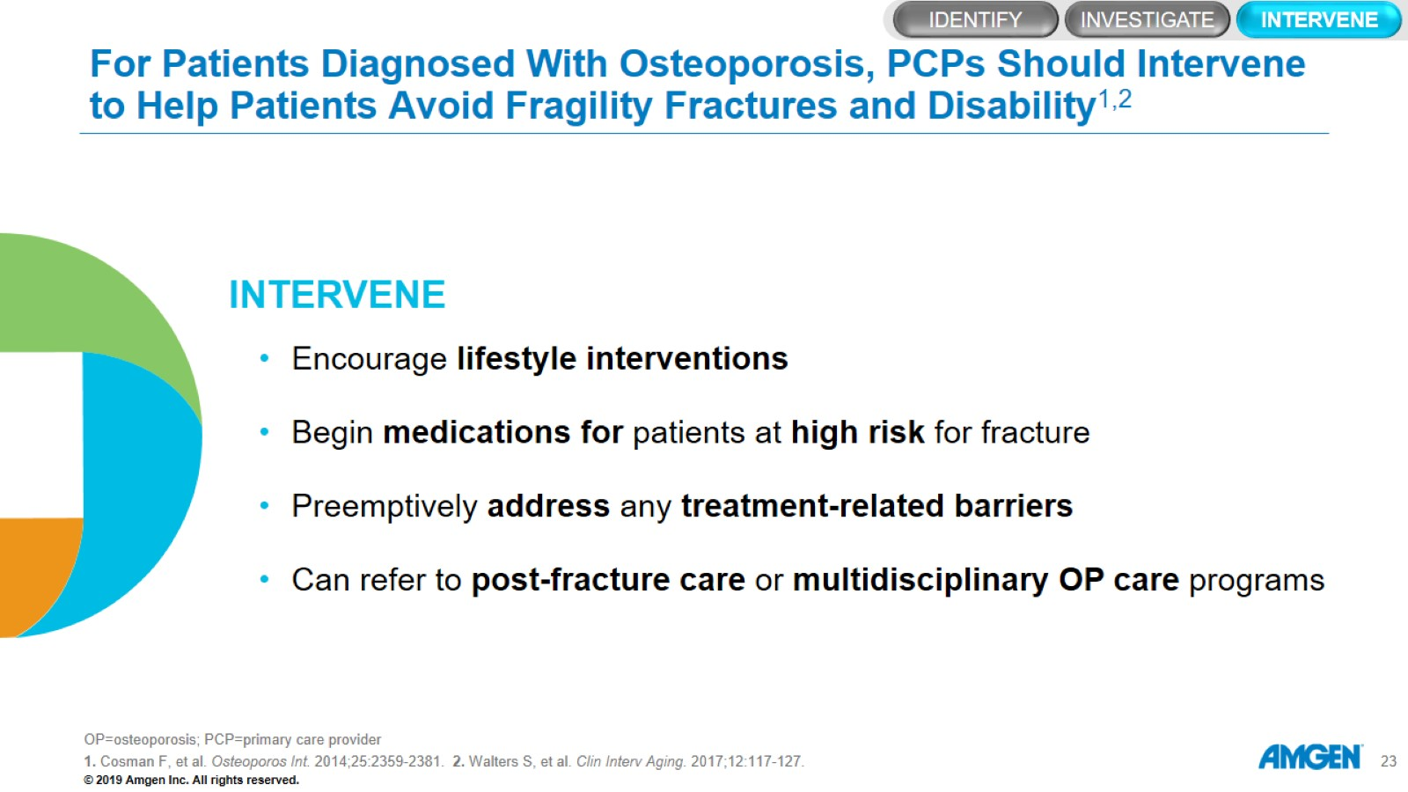
For Patients Diagnosed With Osteoporosis, PCPs Should Intervene to Help Patients Avoid Fragility Fractures and Disability^{1,2}

Slide 24
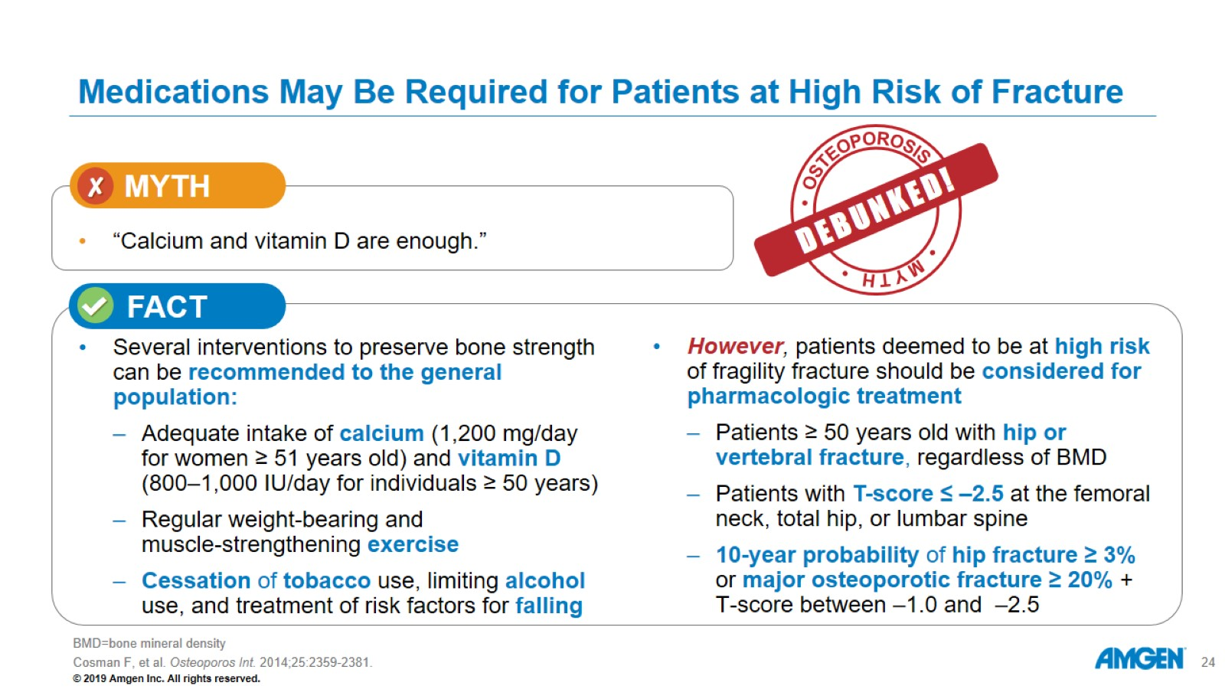
Medications May Be Required for Patients at High Risk of Fracture

Slide 25
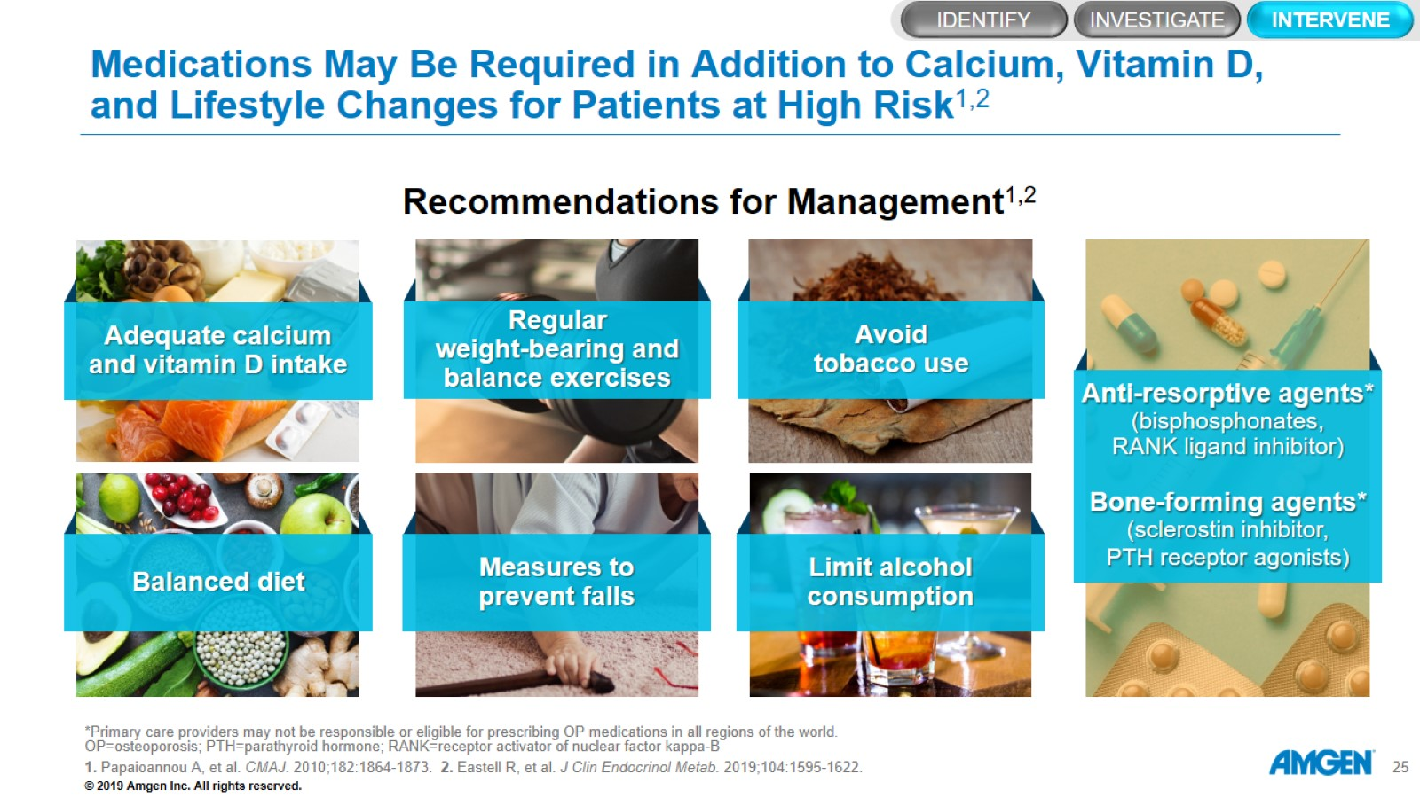
Medications May Be Required in Addition to Calcium, Vitamin D, and Lifestyle Changes for Patients at High Risk^{1,2}

Slide 26
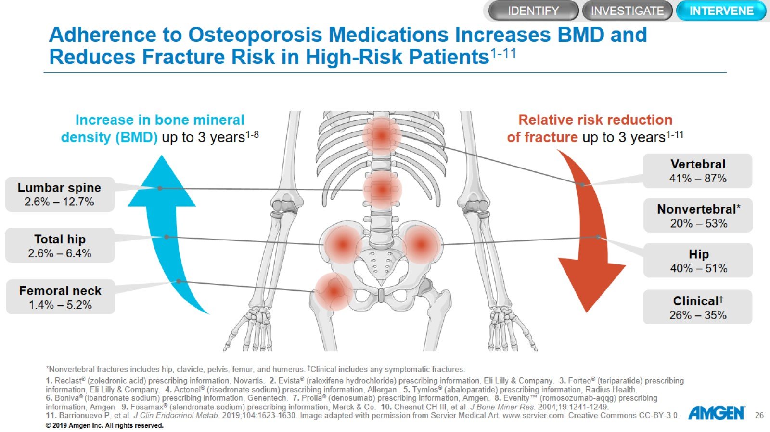
Adherence to Osteoporosis Medications Increases BMD and Reduces Fracture Risk in High-Risk Patients¹⁻¹¹

Slide 27
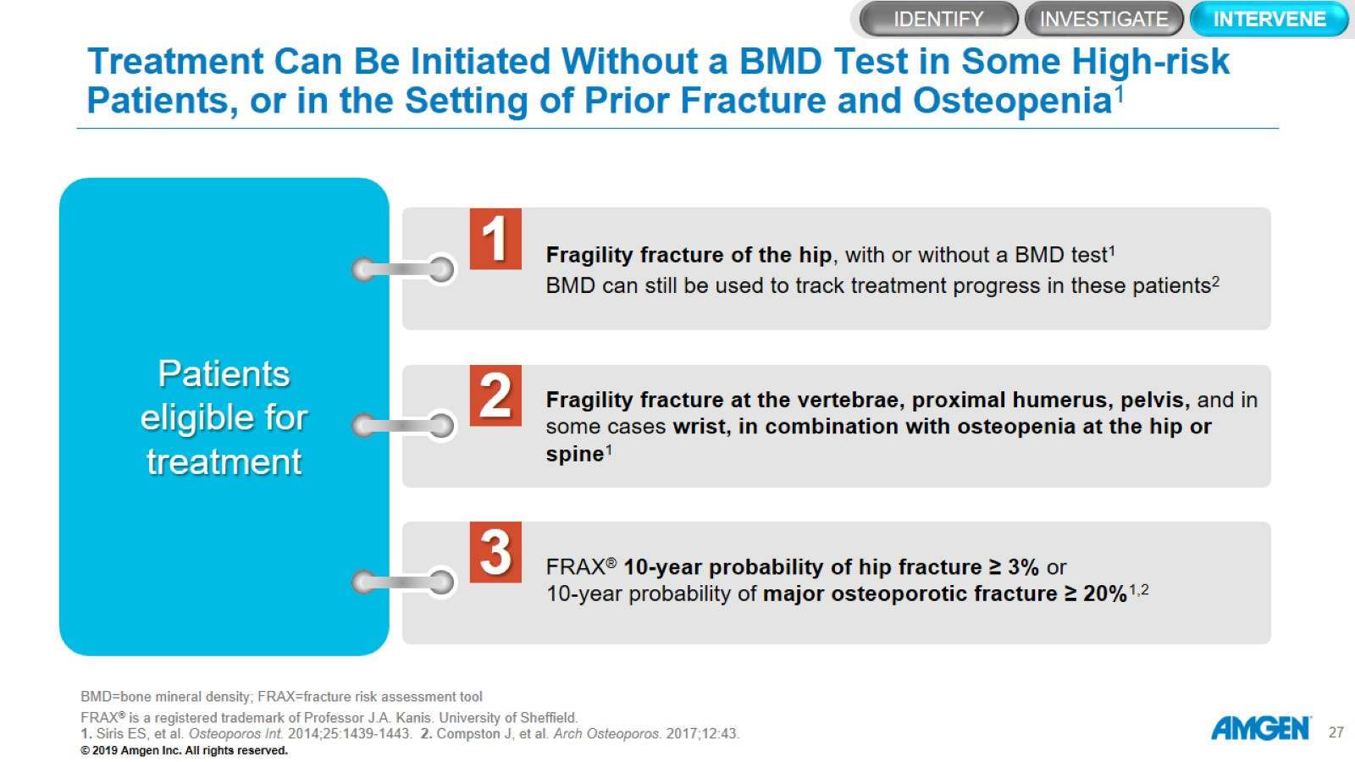
Treatment Can Be Initiated Without a BMD Test in Some High‑risk Patients, or in the Setting of Prior Fracture and Osteopenia¹

Slide 28
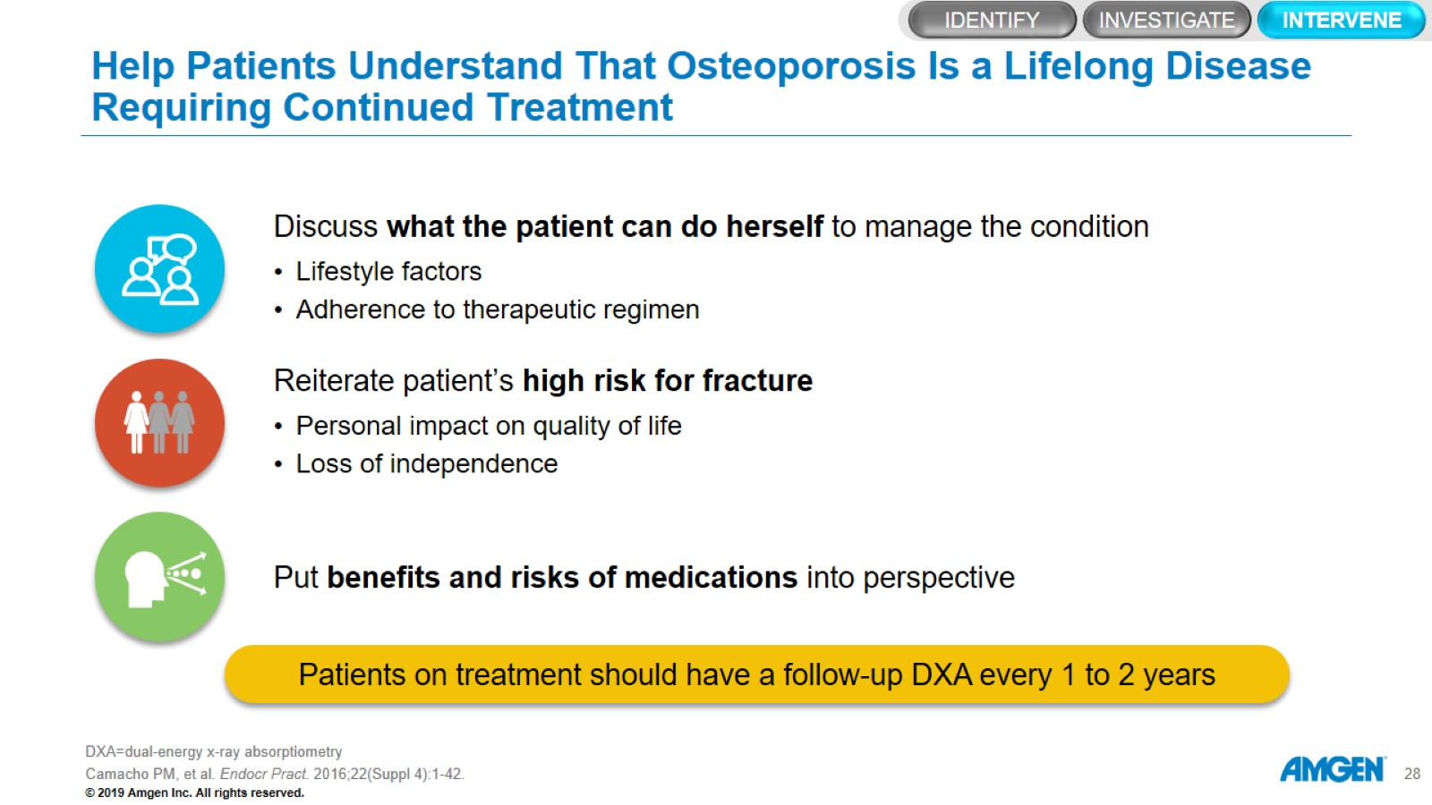
Help Patients Understand That Osteoporosis Is a Lifelong Disease Requiring Continued Treatment

Slide 29
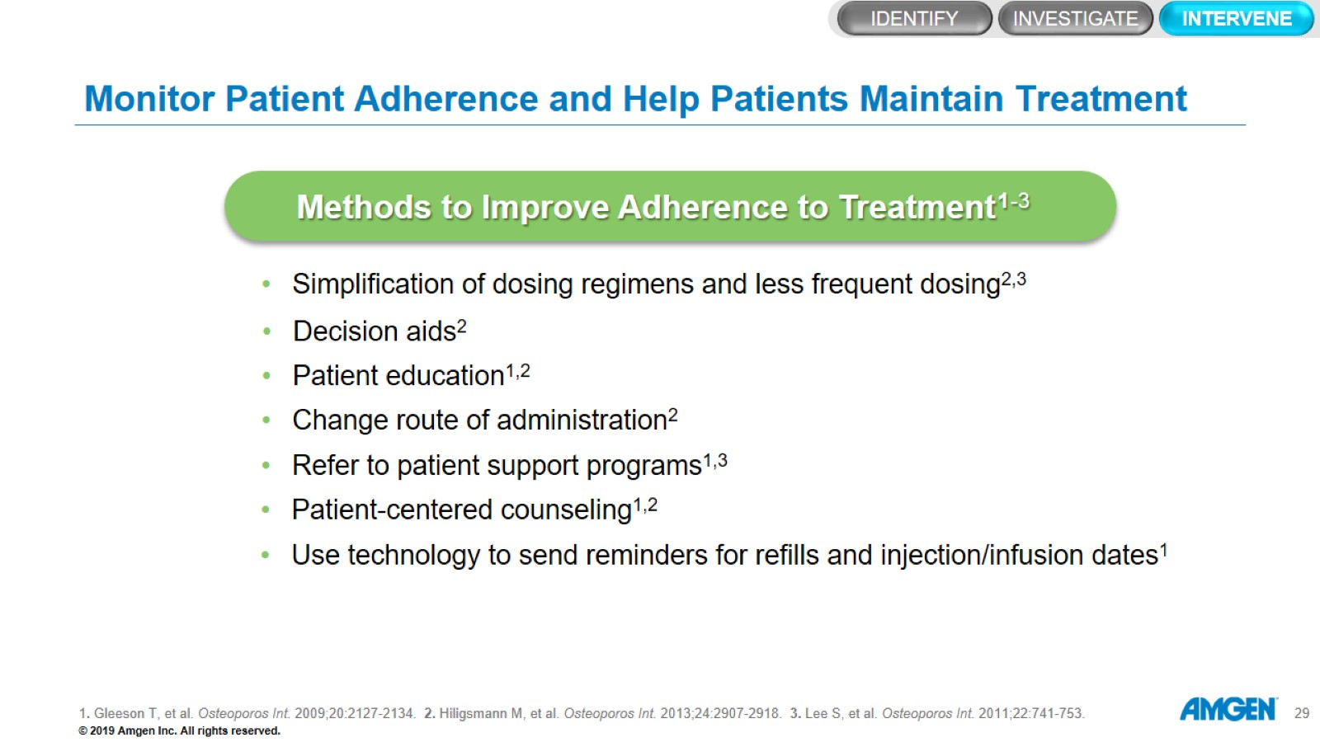
Monitor Patient Adherence and Help Patients Maintain Treatment

Slide 30
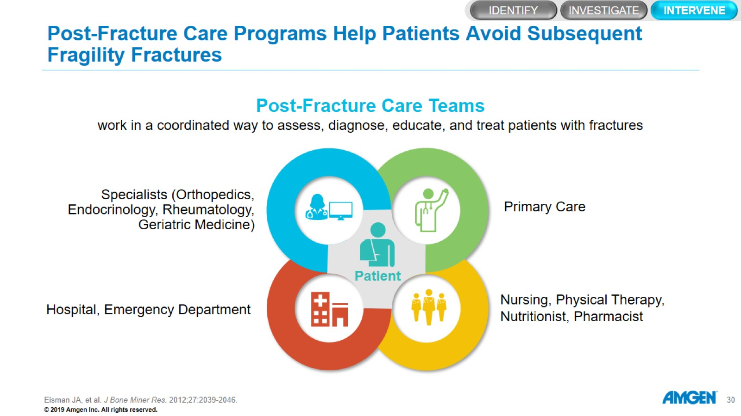
Post-Fracture Care Programs Help Patients Avoid Subsequent Fragility Fractures

Slide 31
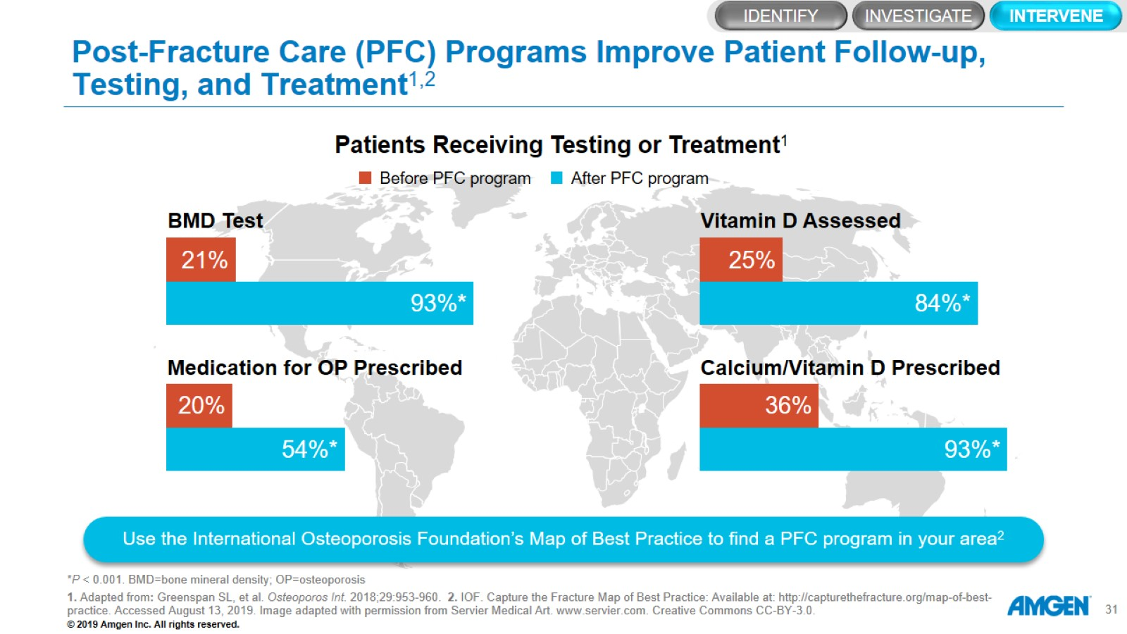
Post-Fracture Care (PFC) Programs Improve Patient Follow-up, Testing, and Treatment^{1,2}

Slide 32
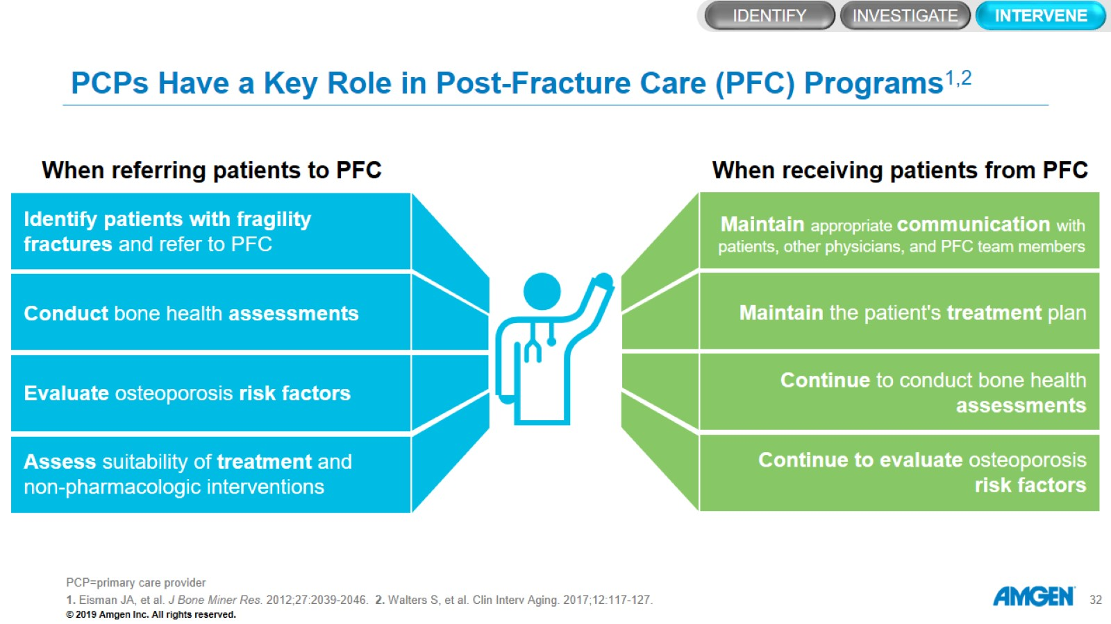
PCPs Have a Key Role in Post-Fracture Care (PFC) Programs^{1,2}

Slide 33
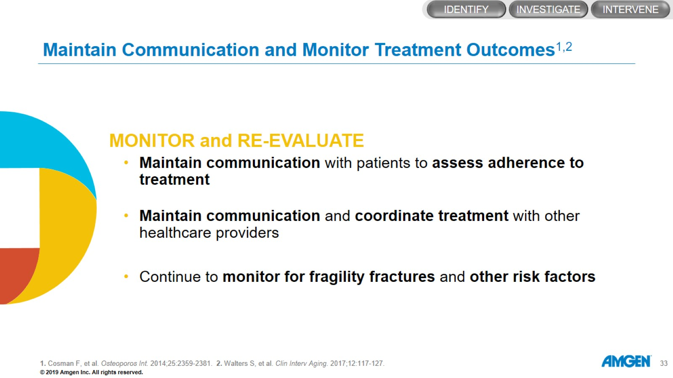
Maintain Communication and Monitor Treatment Outcomes^{1,2}

Slide 34
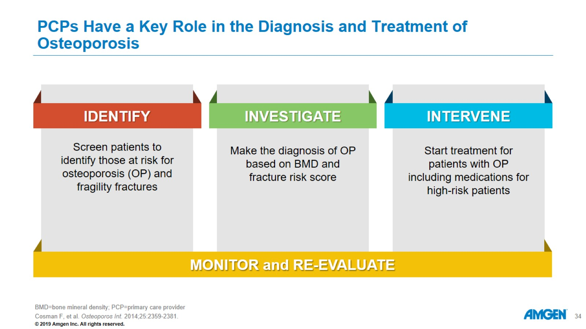
PCPs Have a Key Role in the Diagnosis and Treatment of Osteoporosis

Slide 35
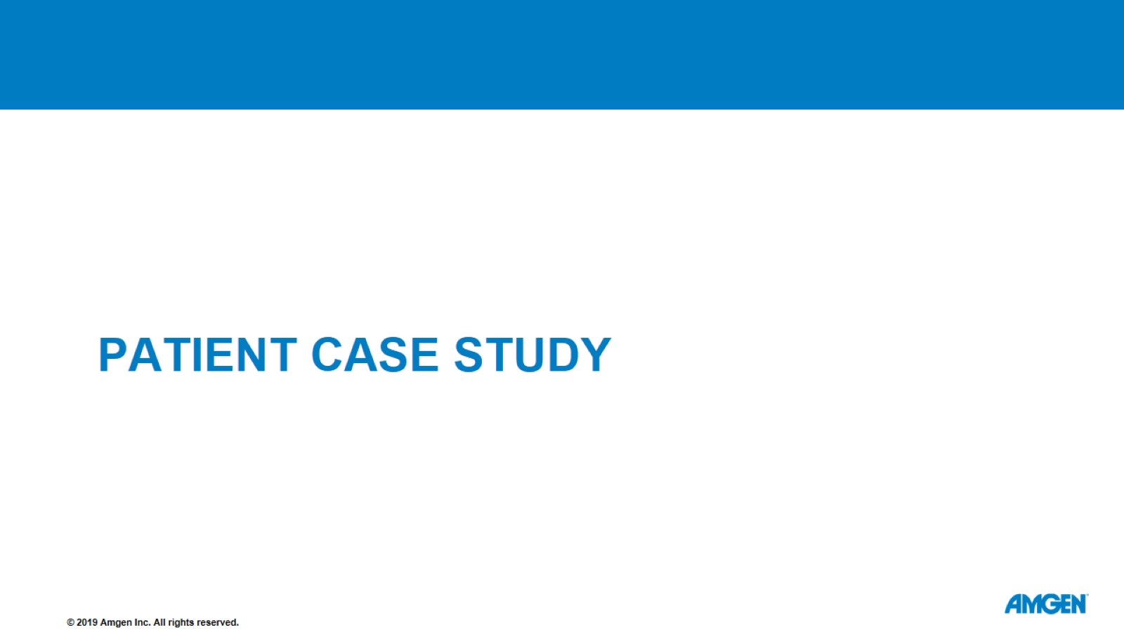
Patient Case Study

Slide 36
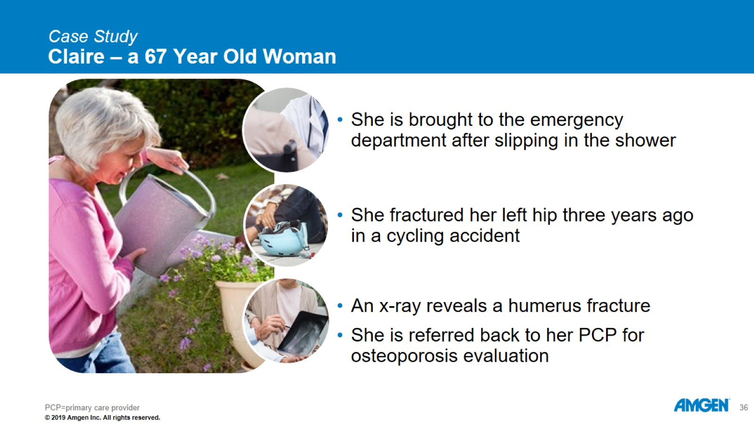
Case Study
Claire – a 67 Year Old Woman

Slide 37
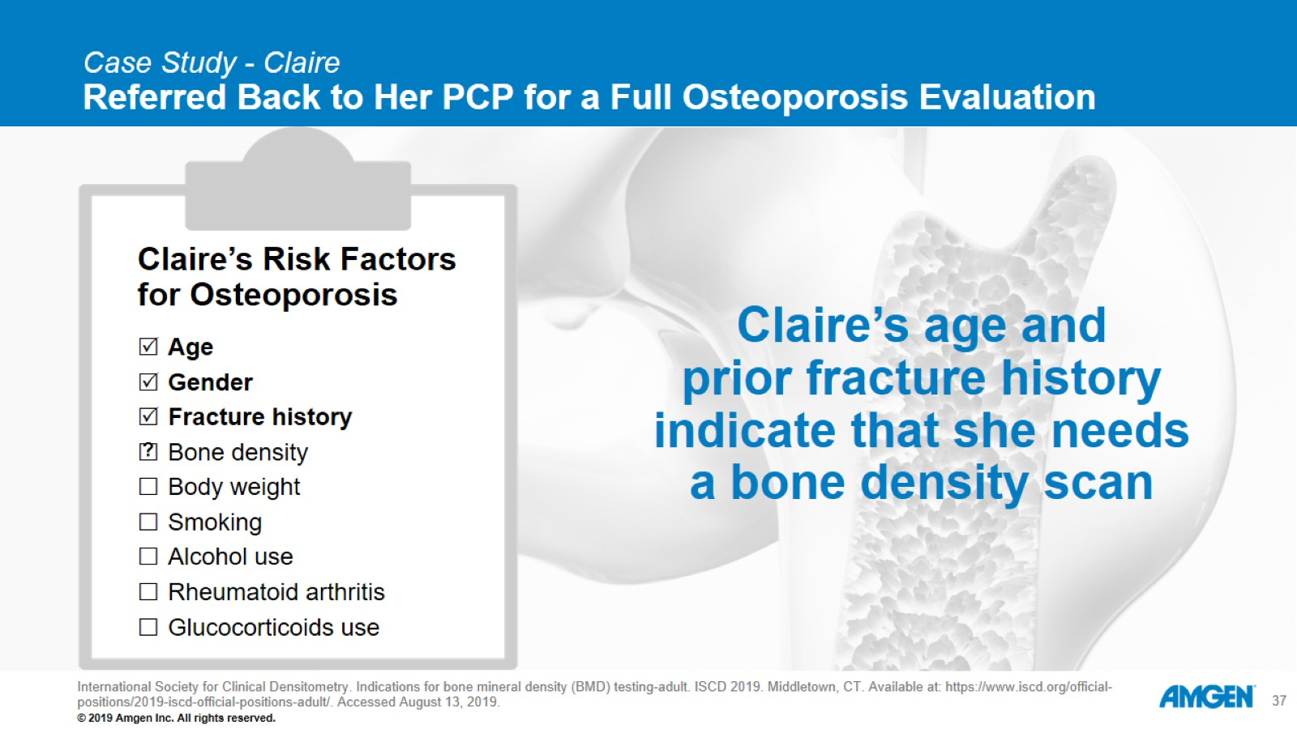
Case Study - Claire
Referred Back to Her PCP for a Full Osteoporosis Evaluation

Slide 38
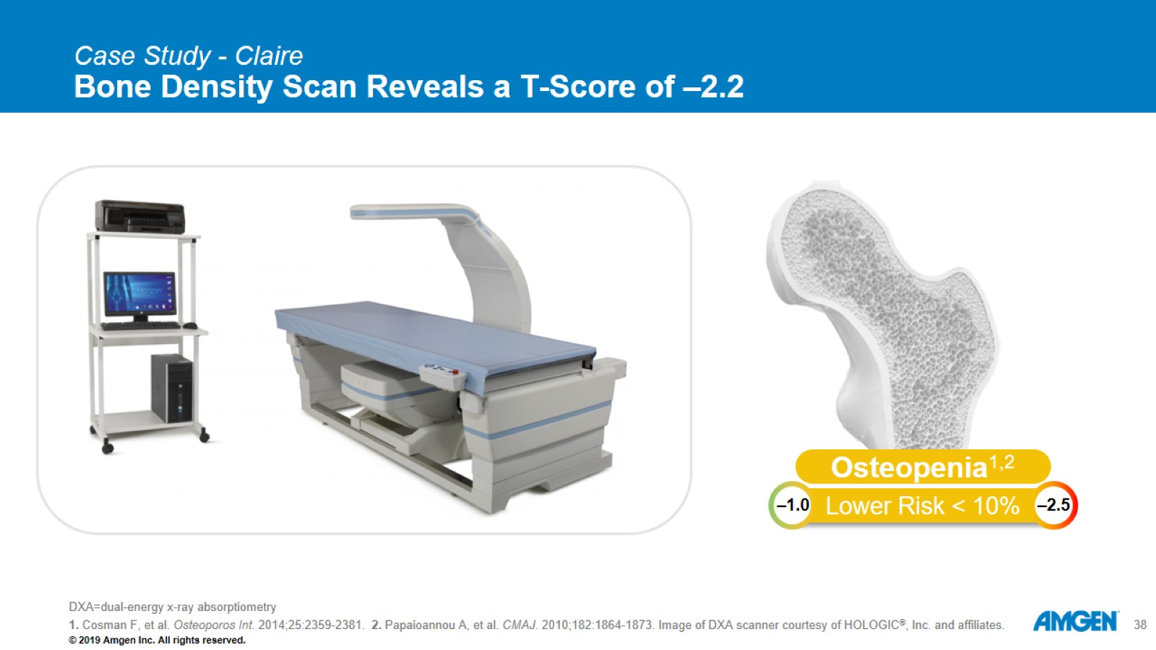
Case Study - Claire
Bone Density Scan Reveals a T-Score of –2.2

Slide 39
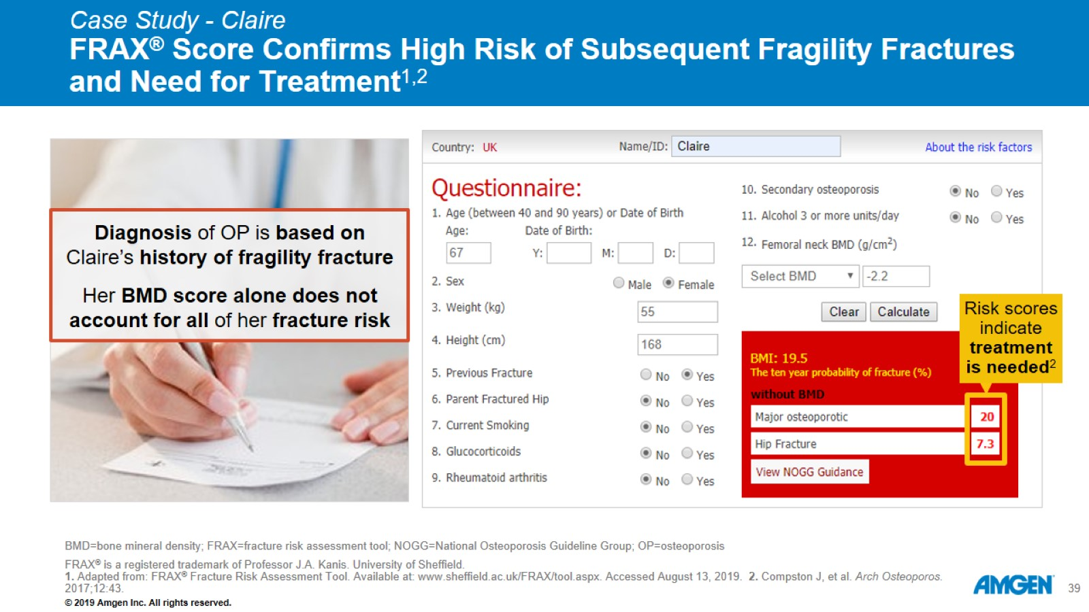
Case Study - Claire
FRAX® Score Confirms High Risk of Subsequent Fragility Fractures and Need for Treatment^{1,2}

Slide 40
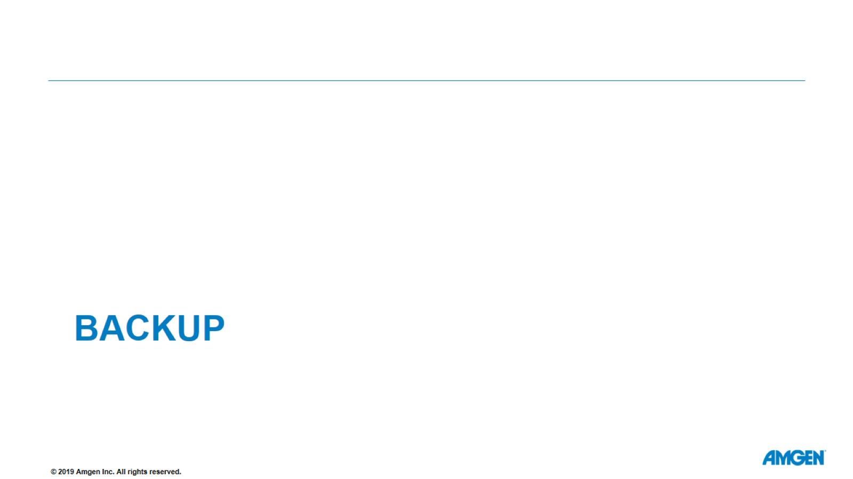
backup

Slide 41
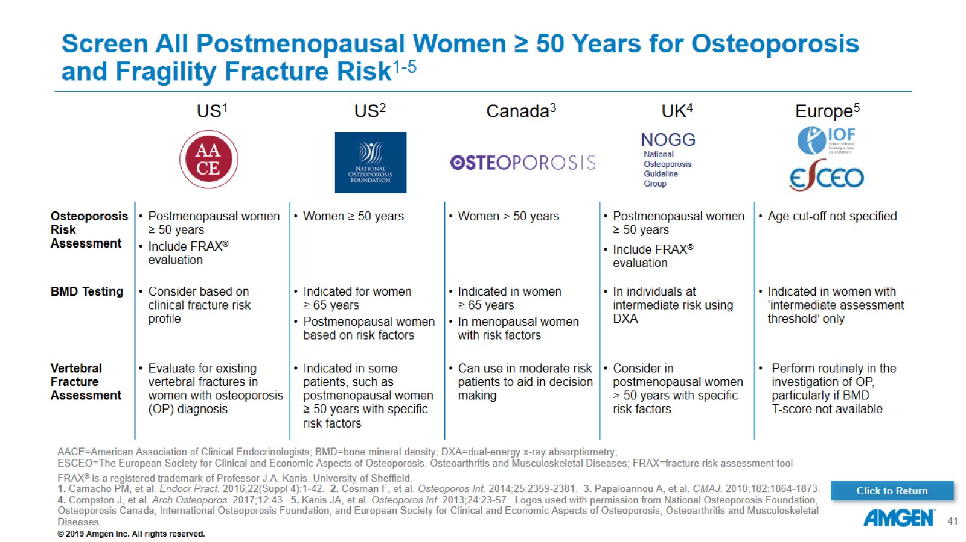
Screen All Postmenopausal Women ≥ 50 Years for Osteoporosis and Fragility Fracture Risk¹⁻⁵

